Slide 1
ASSEMBLING LANGUAGE OVERVIEW
Basic Terms in Assembly Language
Label
Label is an optional ﬁrst ﬁeld of an assembly statement. Labels are alphanumeric names used to deﬁne the starting location of a block of statements.
Labels can be subsequently used in our program as an operand of some other instruction. When creating the executable ﬁle the assembler will replace the label with the assigned value.
Labels must be unique in the executable ﬁle because an identical label encountered by the Assembler will generate an error.

Slide 2
Opcode (Mnemonics)
Opcode is the second ﬁeld in assembly language instruction. Assembly language consists of mnemonics, each corresponding to a machine instruction.
Using a mnemonic you can decide what operation you want to perform on the operands. Assembler must translate each mnemonic opcode into their binary equivalent.
In assembly language mnemonic form an opcode is a command such as MOV or ADD or JMP.
For example
MOV AL, 34h
The opcode is the MOV instruction. The other parts are called the 'operands'.
Operands are manipulated by the opcode. In this example, the operands are the register named AL and the value 34 hex.

Slide 3
Operands
Next to the opcode is the operand ﬁeld which might contain diﬀerent number of operands. Some of the instructions in Cortex-M3 will have no operand while other might have as many as four operands.
The number of operands in an instruction depends on the type of instruction, and the syntax format of the operand can also be diﬀerent. Normally, the ﬁrst operand is the destination of the operation.
In assembly language mnemonic form an opcode is a command such as MOV or ADD or JMP.
For example
MOV AL, 34h

Slide 4
Comments
Comments are messages intended only for human consumption. They have no eﬀect on the translation process and indeed are not acted on by the Assembler.
The comment ﬁeld of an assembly language instruction is also optional. A semicolon signifies that the rest of the line is a comment and is to be ignored by the assembler.
Following are some examples of typical assembly language statements with comments:
INC COUNT ; Increment the memory variable COUNT
MOV TOTAL, 48 ; Transfer the value 48 in the

Slide 5
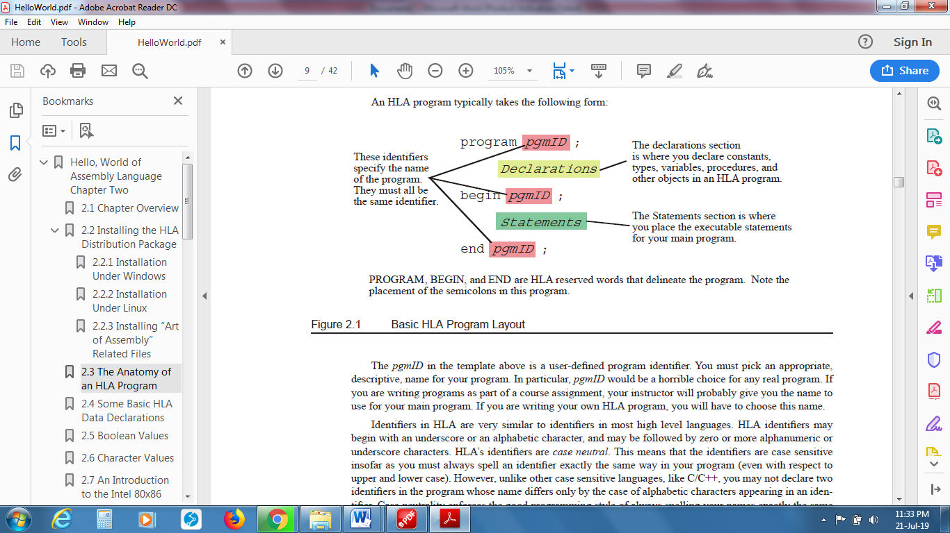
ASSEMBLY LANGUAGE PROGRAM LAYOUT

Slide 6
CPU Registers
Registers are special memory locations on the CPU. At this point, we'll assume the reader is programming for computers using 386 or later processors.
Older processors are very rare at this time, so it would be a waste of time to learn about them. One important difference between older and later processors is that the pre-386 processors are 16-bit instead of 32-bit.
There are 8 32-bit general purpose registers. The first 4, eax, ebx, ecx, and edx can also be accessed using 16 or 8-bit names. ax gets the first 16 bits of eax, al gets the first 8 bits, and ah gets bits 9-16. The other registers can be accessed in a similar fashion.
Supposedly, these registers can be used for anything, although most have a special use:

Slide 7
Address Name Description
EAX* Accumulator Register calculations for operations and results data
EBX Base Register pointer to data in the DS segment
ECX* Count Register counter for string and loop operations
EDX* Data Register input/output pointer
ESI Source Index source pointer for string operations
EDI Destination Index destination pointer for string operations
ESP Stack Pointer stack pointer, should not be used
EBP Base Pointer pointer to data on the stack

Slide 8
There are 6 16-bit segment registers. They define segments in memory:
Address Name Description
CS Code Segment where instructions being executed are stored
DS, ES, FS, GS Data Segment data segment
SS Stack Segment where the stack for the current program is stored
Lastly, there are 2 32-bit registers that don't fit into any category:
Address Name Description
EFLAGS Code Segment status, control, and system flags
EIP Instruction Pointer offset for the next instruction to be executed

